Slide 1
DBW301 Final Project

Slide 2
Table of content
1. Team introduction
2. Data warehouse requirement
3. Data warehouse Design
4. Demo

Slide 3




1. Team introduction
AnhNN MienNTH PhongVH TrungĐQ

Slide 4
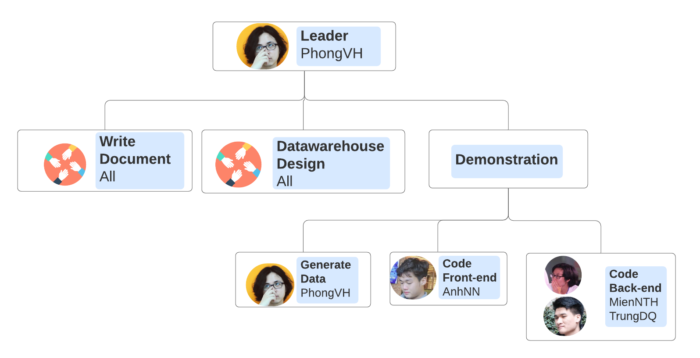
1. Team introduction

Slide 5
3. Data warehouse requirement
Find all the stores along with city, state, phone, description, size, weight and unit price that hold a particular item of stock.
Find all the orders along with customer name and order date that can be fulfilled by a given store.
Find all stores along with city name and phone that hold items ordered by given customer.
Find the headquarter address along with city and state of all stores that hold stocks of an item above a particular level.

Slide 6
3. Data warehouse requirement (con’t)
For each customer order, show the items ordered along with description, store id and city name and the stores that hold the items.
Find the city and the state in which a given customer lives.
Find the stock level of a particular item in all stores in a particular city.
Find the items, quantity ordered, customer, store and city of an order.
Find the walk in customers, mail order customers and dual customers (both walk-in and mail order).

Slide 7
4. Data warehouse design steps
4.1 Convert 2 relational databases Headquarter and Sales into Extended Entity Relationship (EER) model.
4.2 Integrate two EERs into on Integrated ERR (IEER)
4.3 Convert IEER into Integrated Database (IDB)
4.4 Write information packages
4.5 Star schema for data warehouse
4.6 Mapping mechanism from IDB to Data warehouse
4.7 Generate data for data warehouse

Slide 8
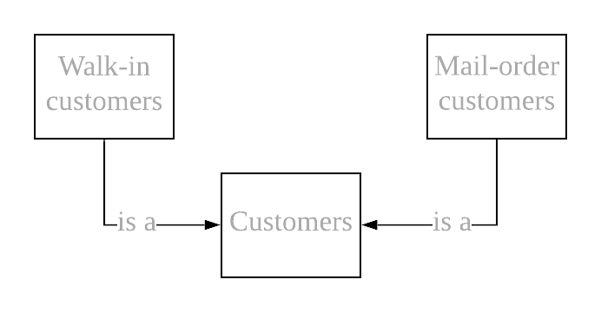
4.1 Convert 2 relational databases Headquarter and Sales into EER model
Headquarter Database
Notes:
Ở cái đầu thì có 3 bảng bảng customer có 2 bảng con là 2 loại khách hang thì 2 cái này đều có FK tham chiếu đén customer
Bảng sale database có 6 bảng mỗi đầu có nhiều store mỗi store có nhiều sỏe

Slide 9
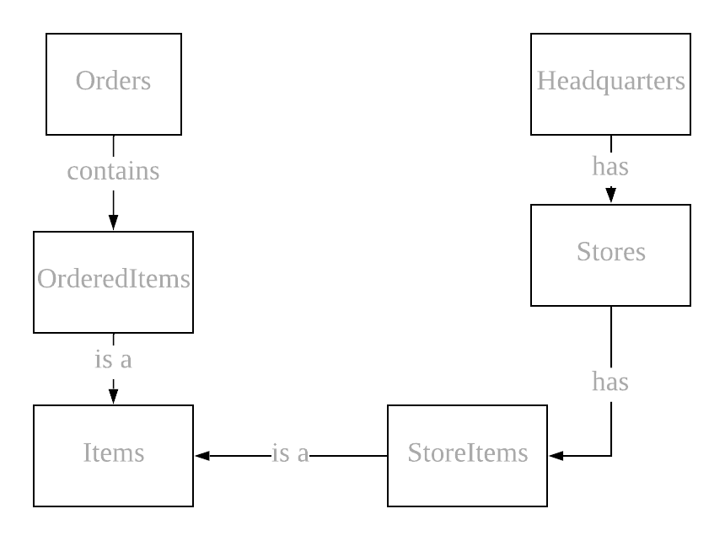
4.1 Convert 2 relational databases Headquarter and Sales into EER model
Sale Database
Notes:
Ở cái đầu thì có 3 bảng bảng customer có 2 bảng con là 2 loại khách hang thì 2 cái này đều có FK tham chiếu đén customer
Bảng sale database có 6 bảng mỗi đầu có nhiều store mỗi store có nhiều sỏe

Slide 10
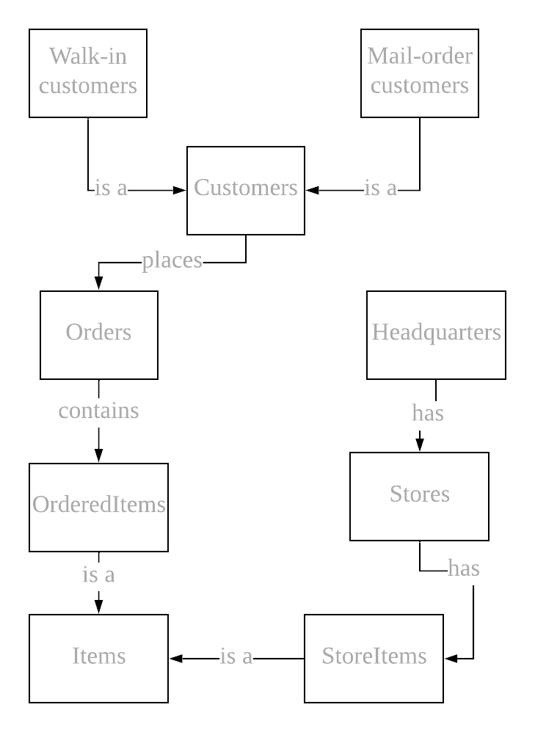
4.2 Integrate two EERs into an IEER

Slide 11
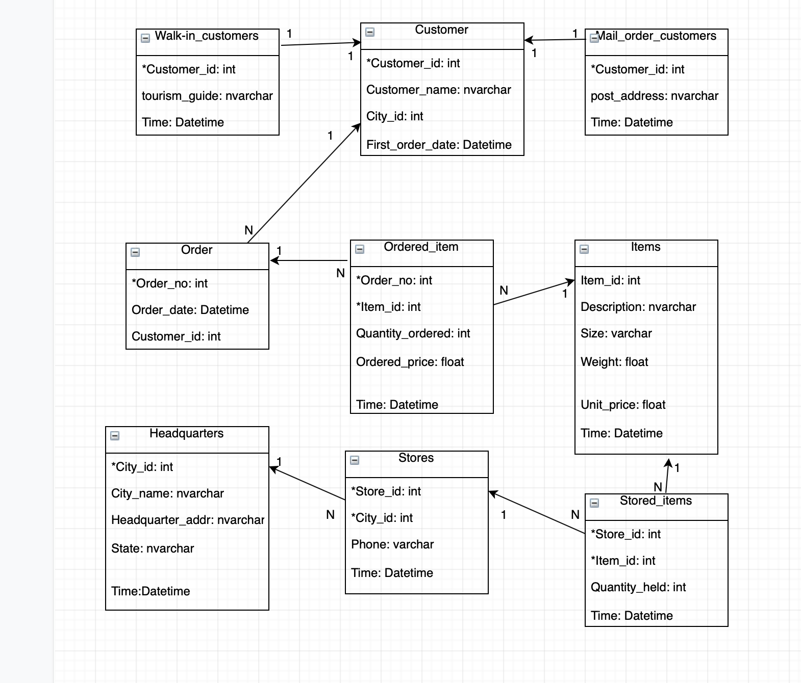
4.3 Convert IEER into IDB
Notes:
Thì ở đây bọn em xác định có 4 dimension mỗi dimenstion có ? Hierachies

Slide 12
4.4 Write information package
Information package: Sale Analysis
 | Dimension
 | Date | Location | Item | Customer
Hierarchies/ Categories | Year | State | Item Name | Customer Name
 | Quarter | City
 | Month | Store
 | Measured facts: Dollars sold, Units sold, Items in stock
Notes:
Thì ở đây bọn em xác định có 4 dimension mỗi dimenstion có ? Hierachies

Slide 13
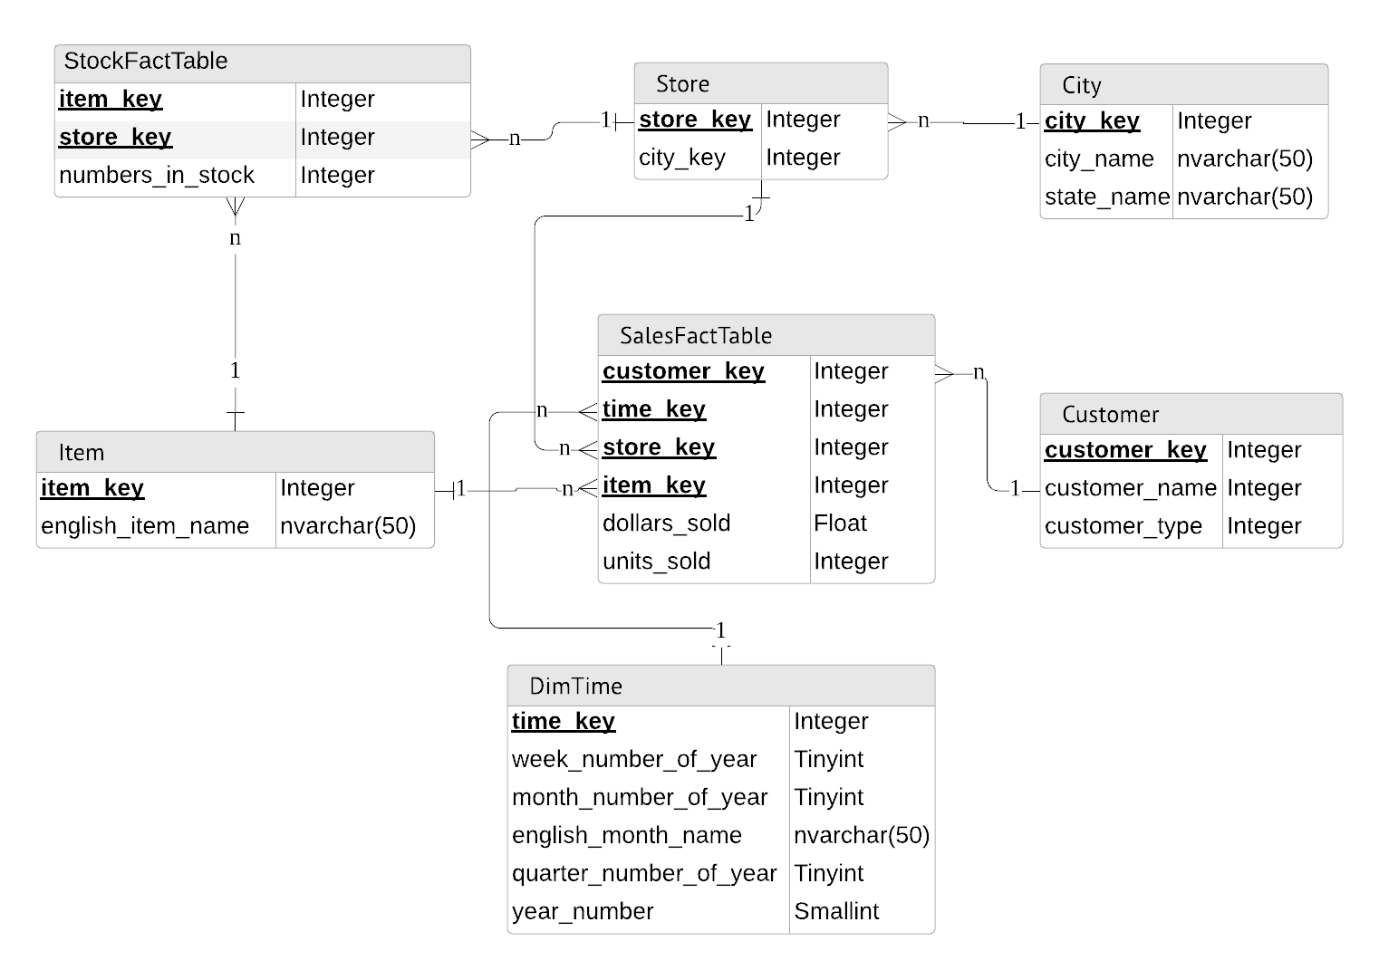
4.5 Star schema for data warehouse
Notes:
Thì ở đây bọn em xác định có 4 dimension mỗi dimenstion có ? Hierachies

Slide 14
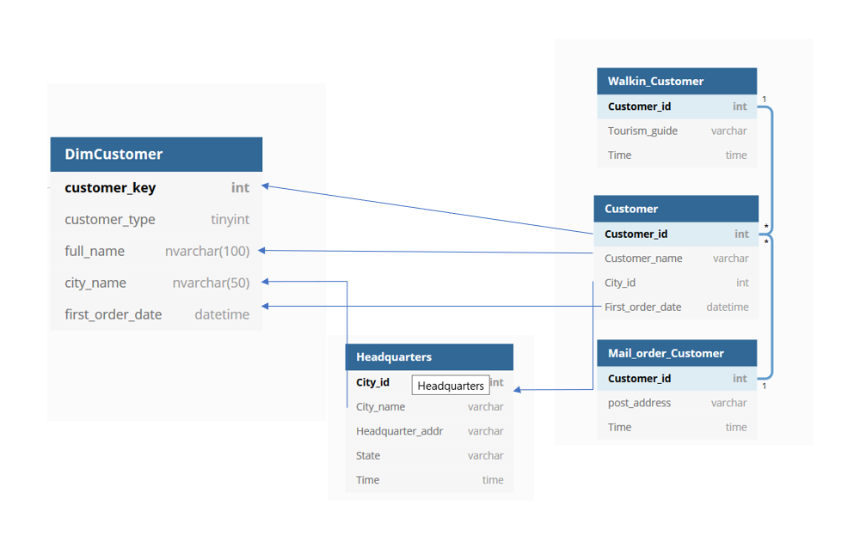
4.6 Mapping mechanism from IDB to Data warehouse

Slide 15
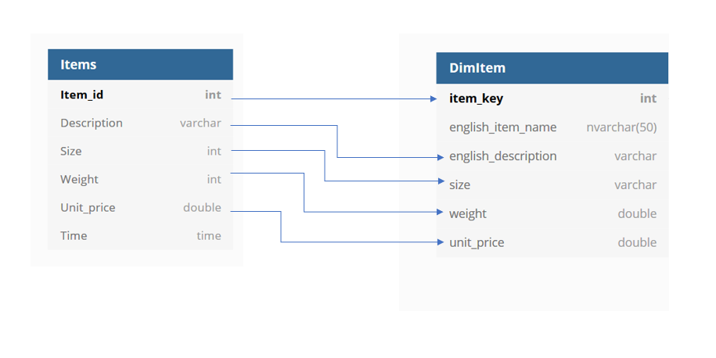
4.6 Mapping mechanism from IDB to Data warehouse

Slide 16
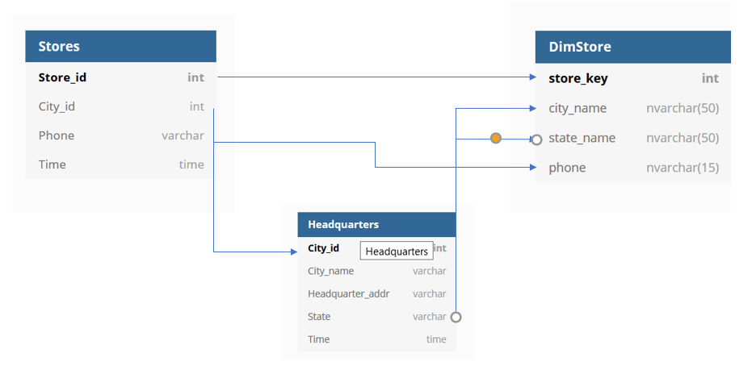
4.6 Mapping mechanism from IDB to Data warehouse

Slide 17
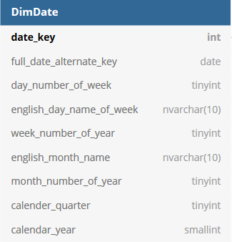
4.6 Mapping mechanism from IDB to Data warehouse

Slide 18
4.7 Generate data for data warehouse
We generated 10.000 records for each dimension table and nearly 40.000 records for SalesFact table.
Steps taken:
=> Generate data to for DBW_Final database
Tools used: Excel + data online generator
=> Import data into database using SQL Server Import and Export Data Wizard
=> Use Visual Studio 2017 Analysis Service Extension to import data from SQL Server to SQL Server analysis service

Slide 19

4.7 Demonstration

Slide 20

for listening!

